Slide 1
CHRISTMAS DECOR
Linked In Office Décor(19000 sq.ft)

Slide 2
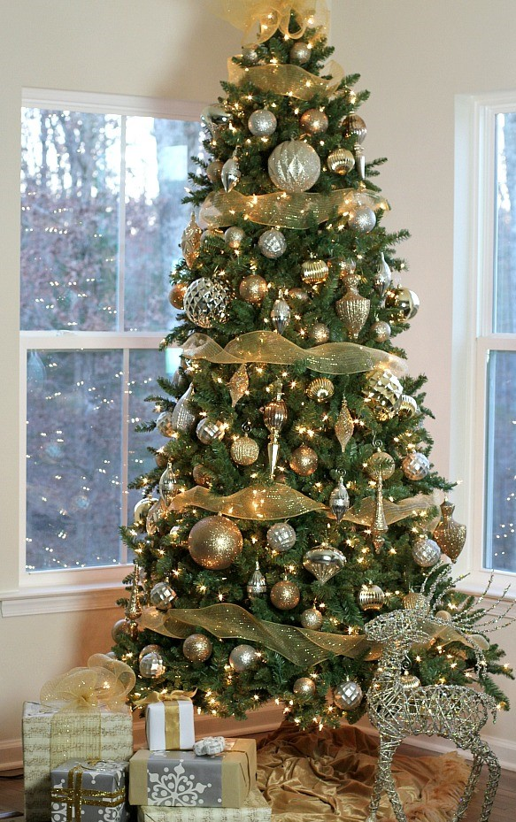
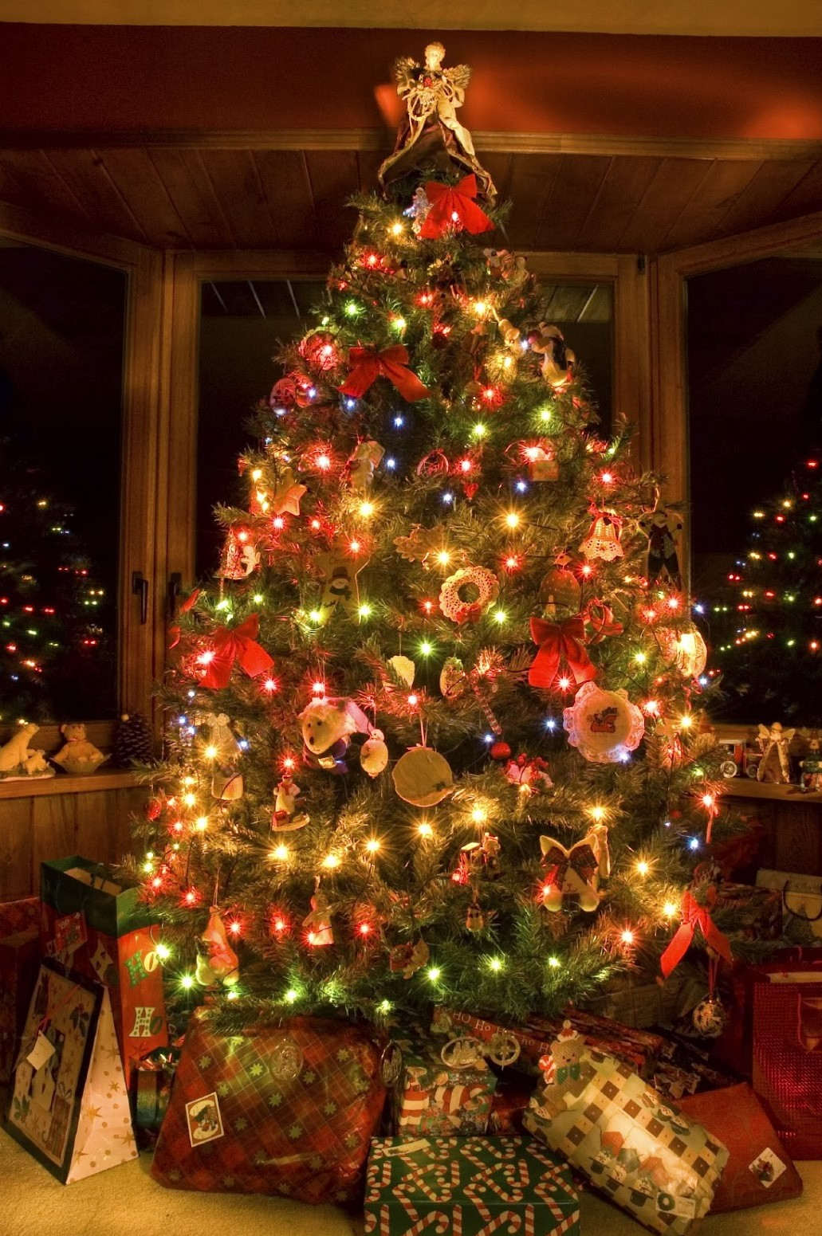
Christmas Tree with Décor : Rs 7000 to Rs. 10000

Slide 3
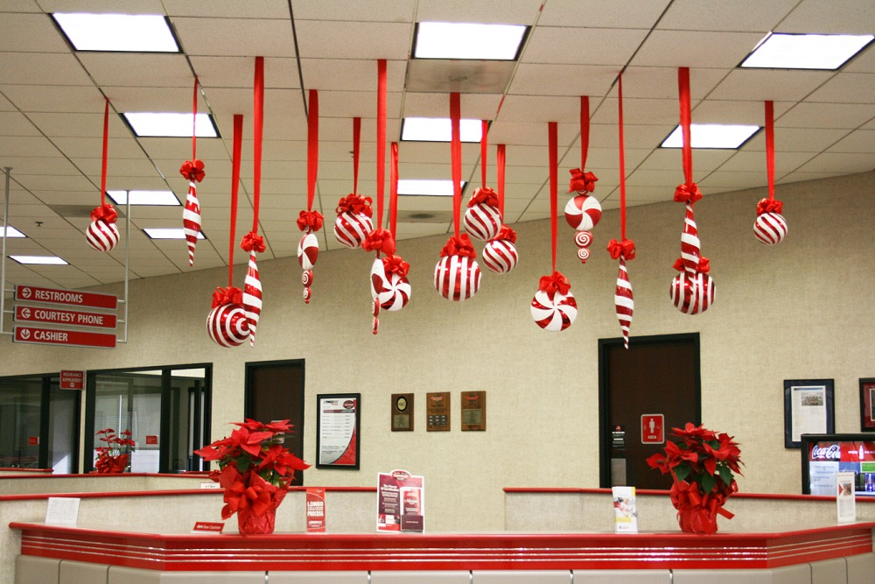
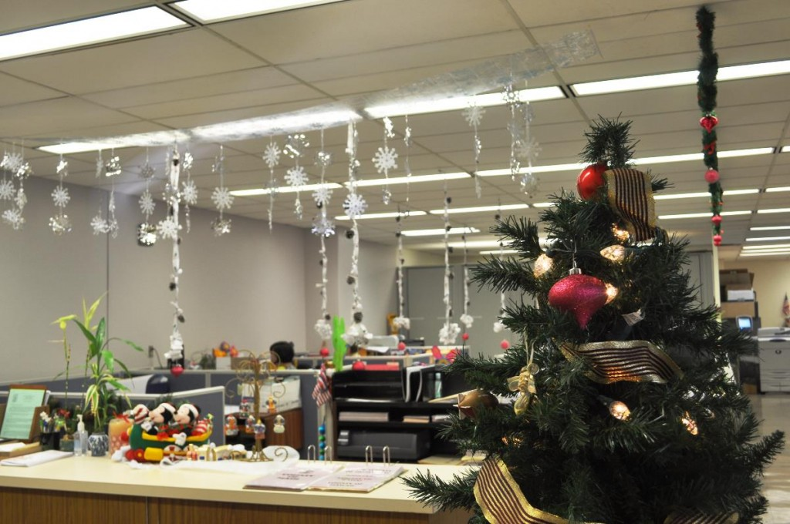
Hanging Elements : Rs. 70 to 120 per element

Slide 4
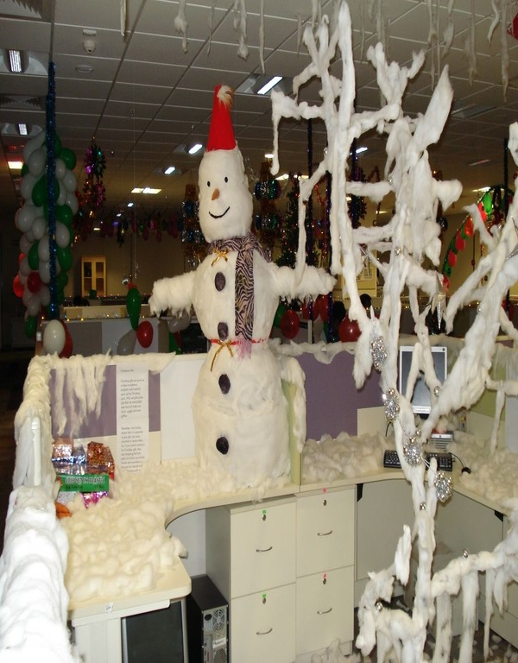
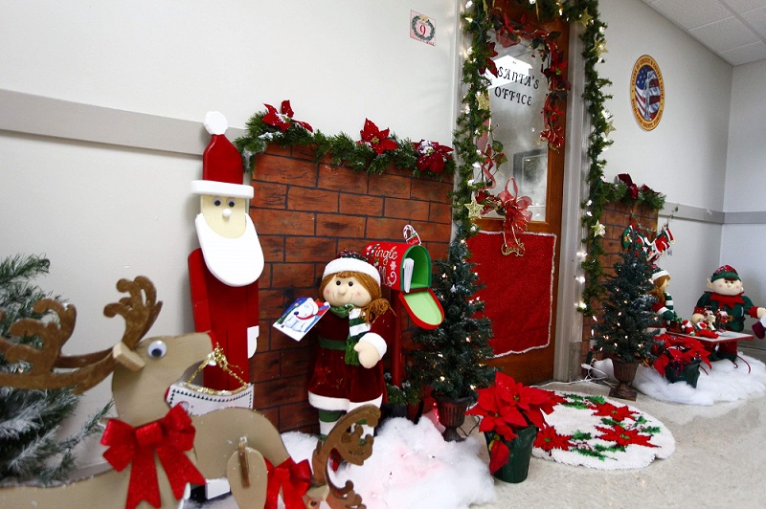
This Set up will cost: Rs.15000 to 20,000

Slide 5
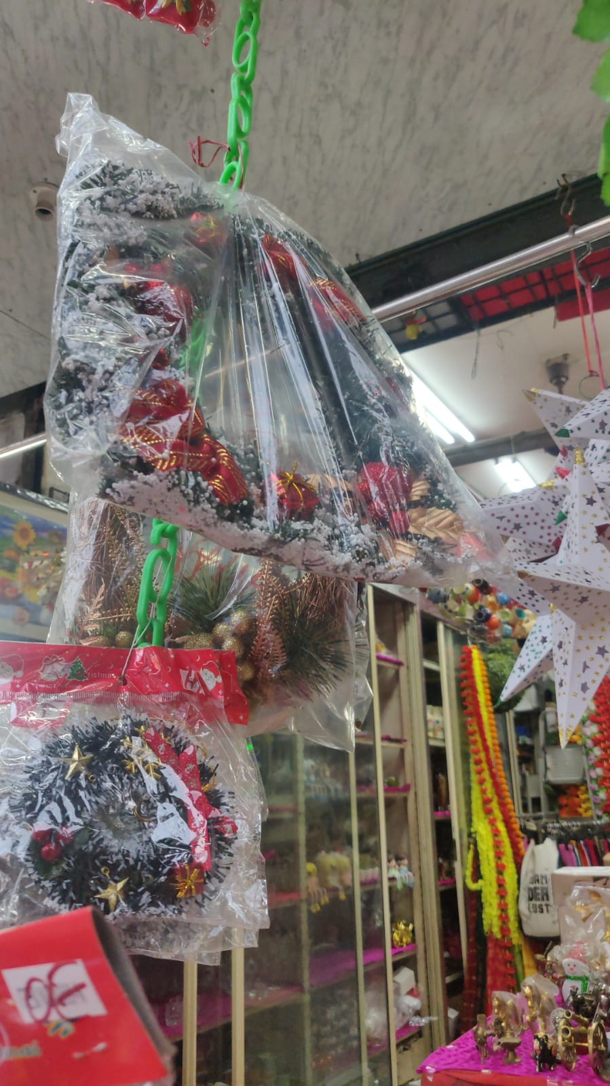
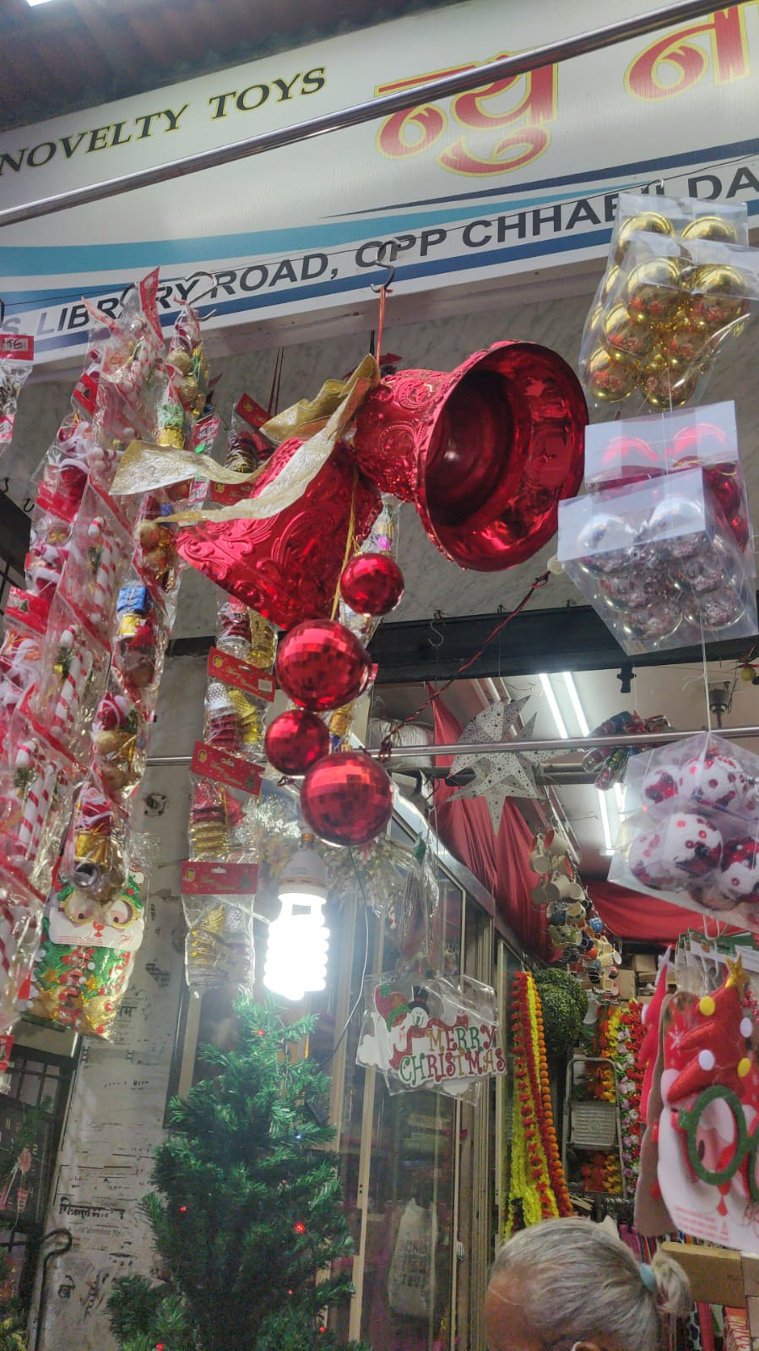
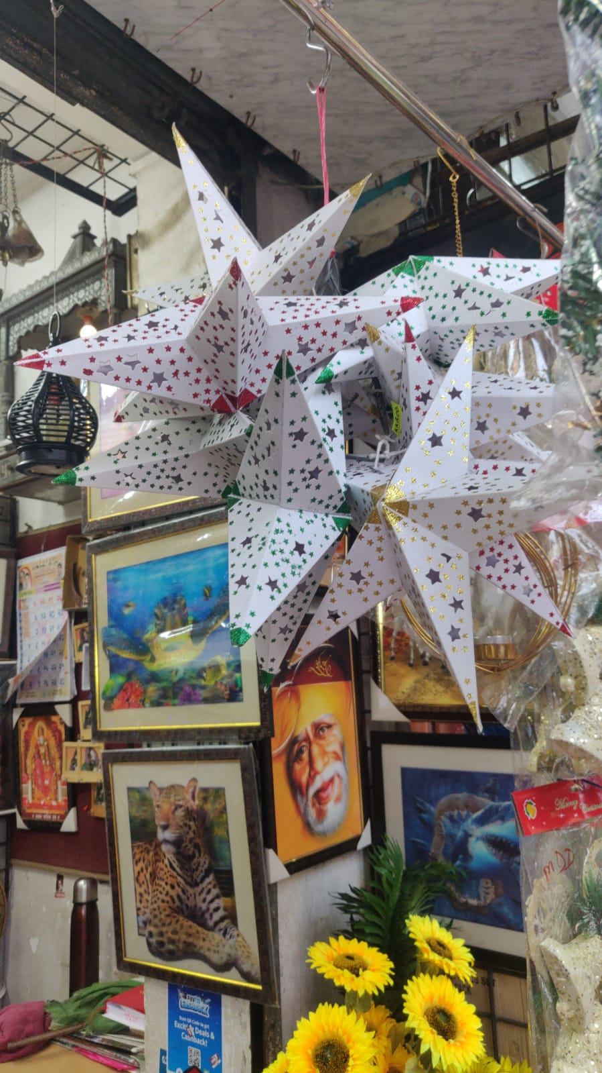
Other Decorative items
Rs. 750
Rs. 1350
Rs. 30

Slide 6
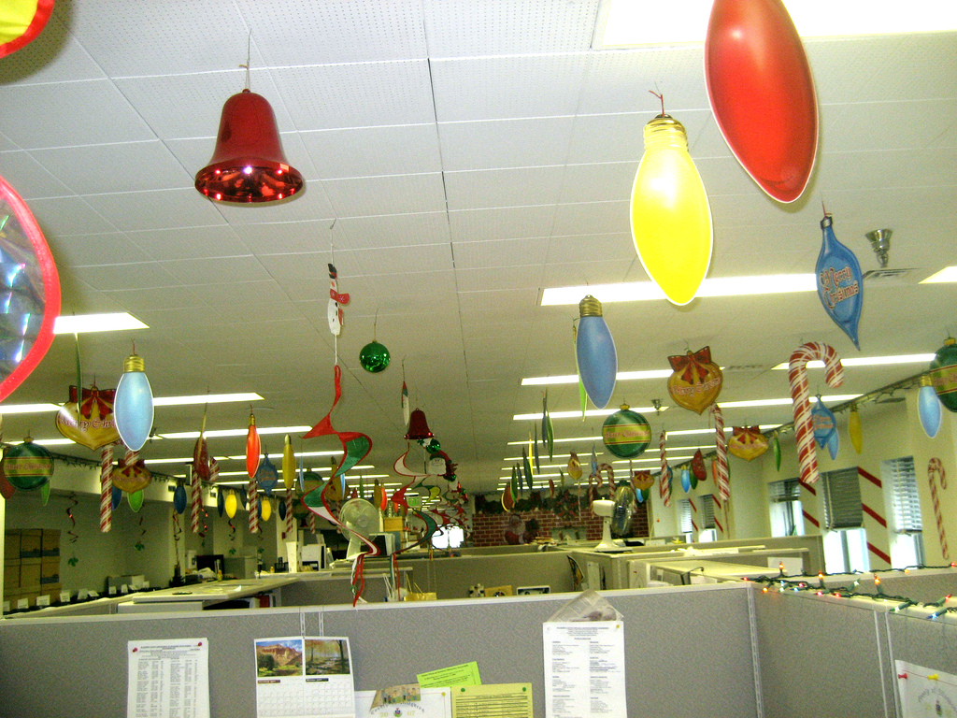
Ceiling Décor Items: Rs. 50 to Rs 70 Per

Slide 7
Décor Information
For a office of 19000 sq.ft we require atleast 2500 to 3000 total props
This will include ceiling & wall props
In addition to this we will be creating additional setups
As per our yesterday’s discussion, minimum cost which will occur for your requirement will come around 1.5 Lac Rs.
Cost can go down if we will reduce the elements
Note:
*If we are going for rented material than cost will go much higher as you require setup for almost 18 days.
* Its recommended to create our own setups to reduce down the cost.

